Slide 1



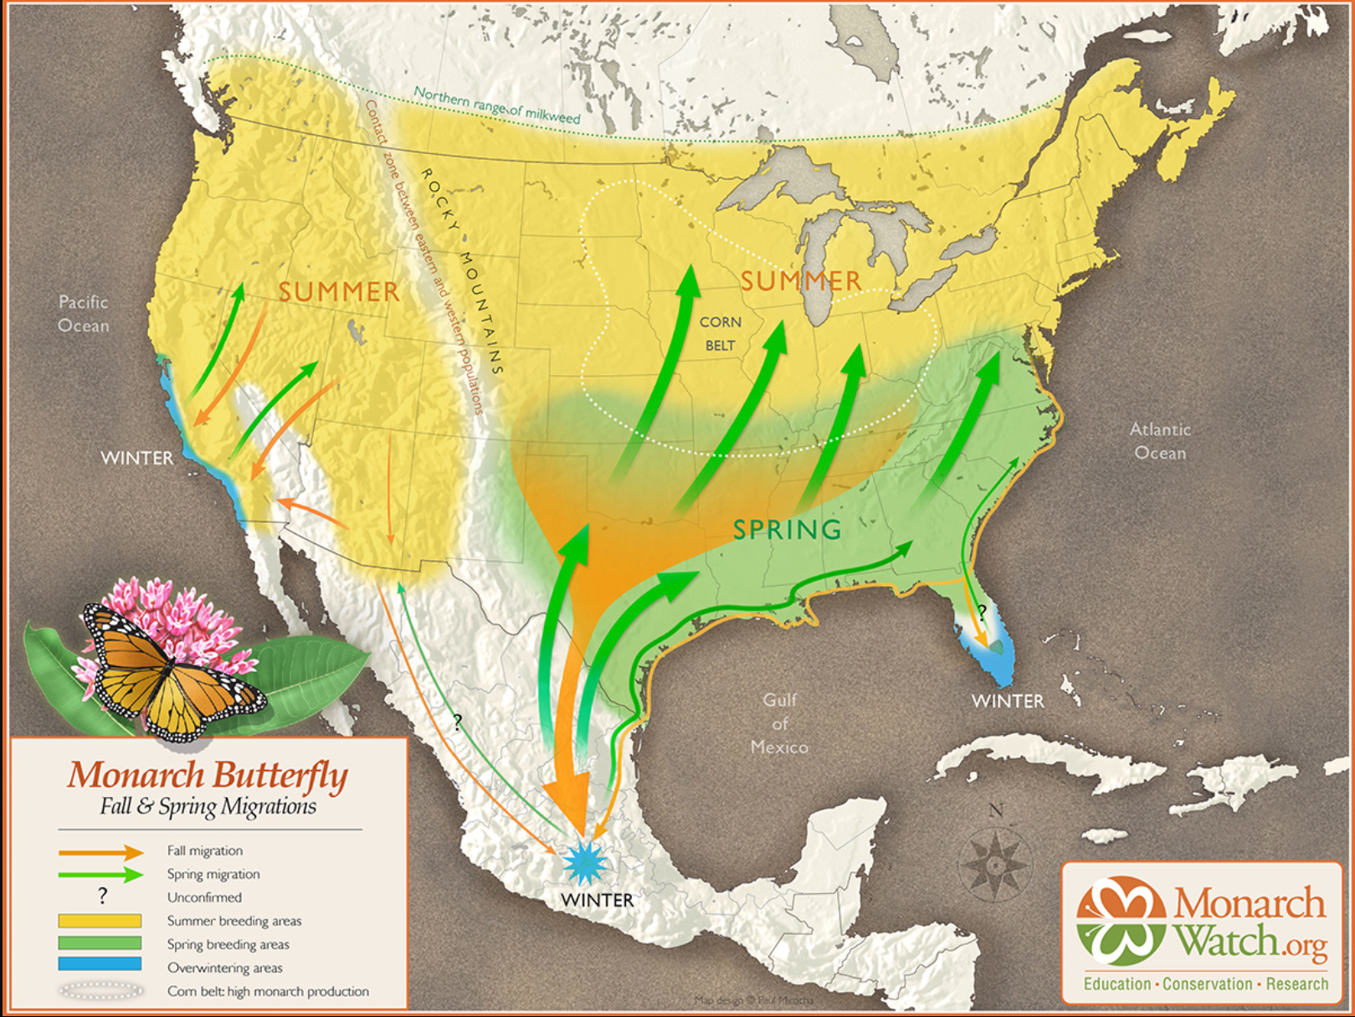
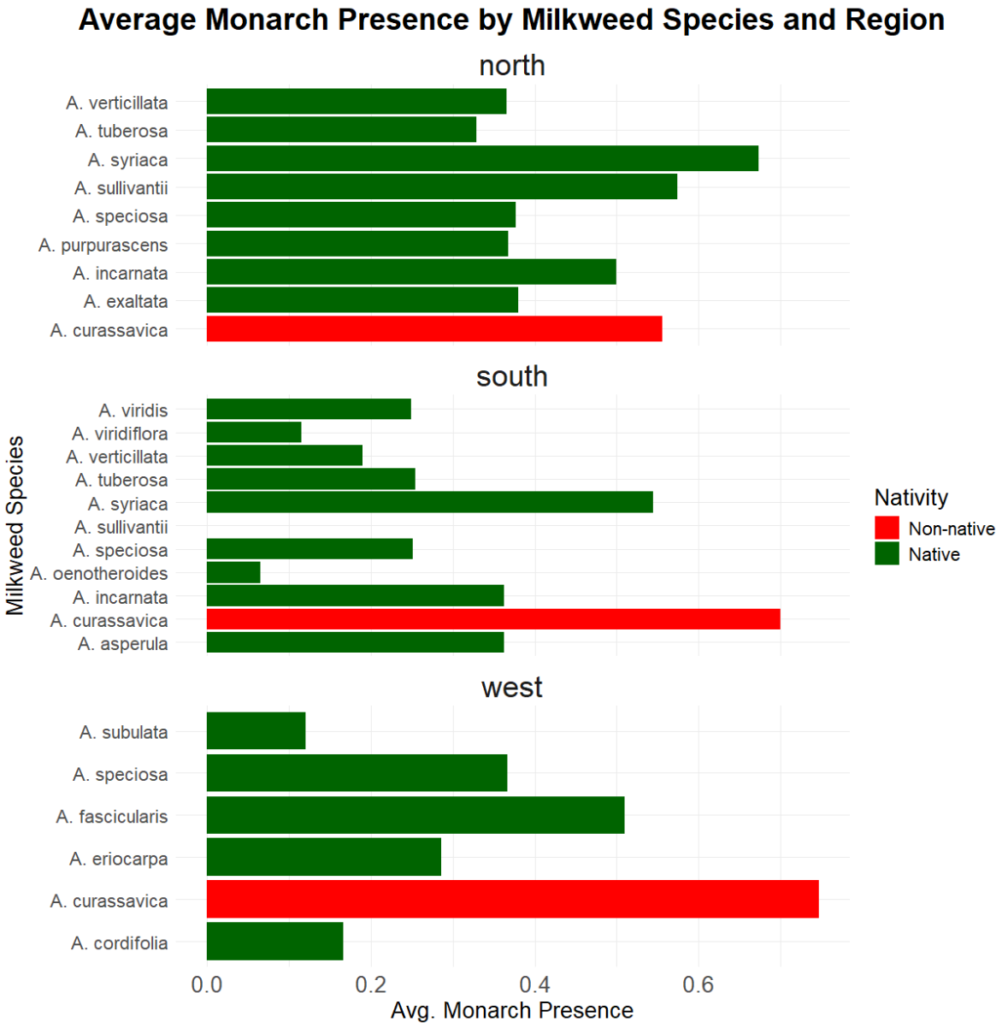
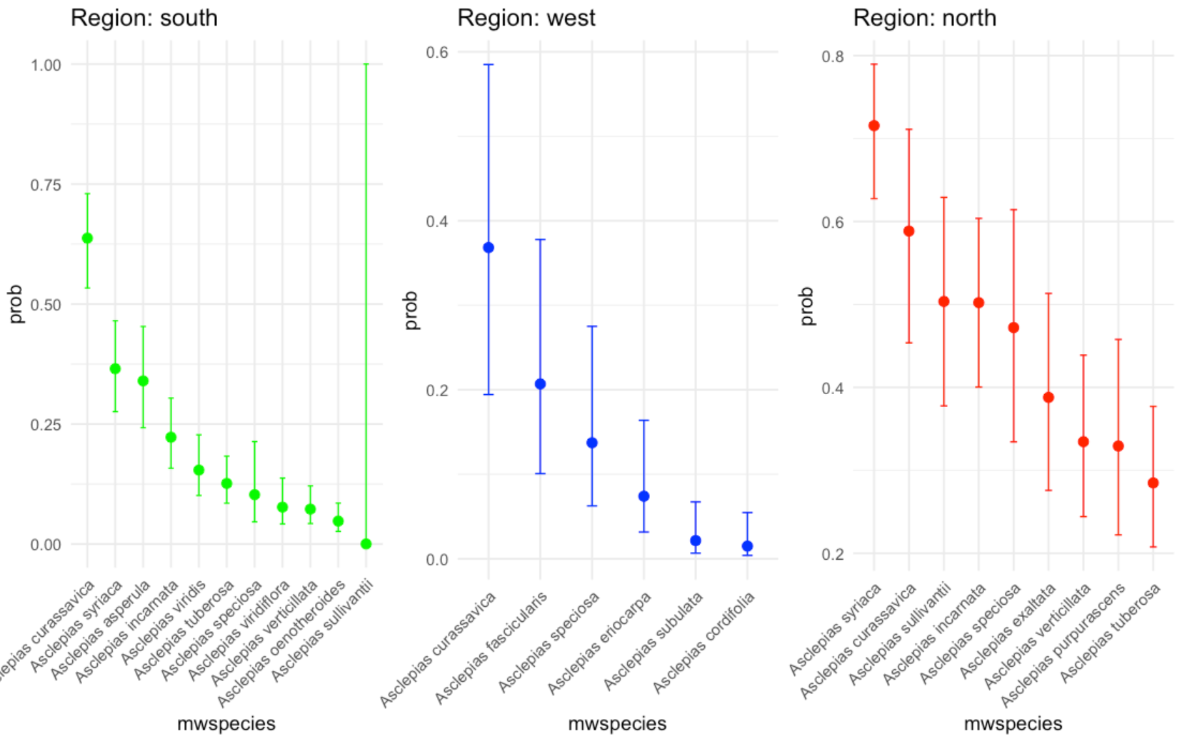
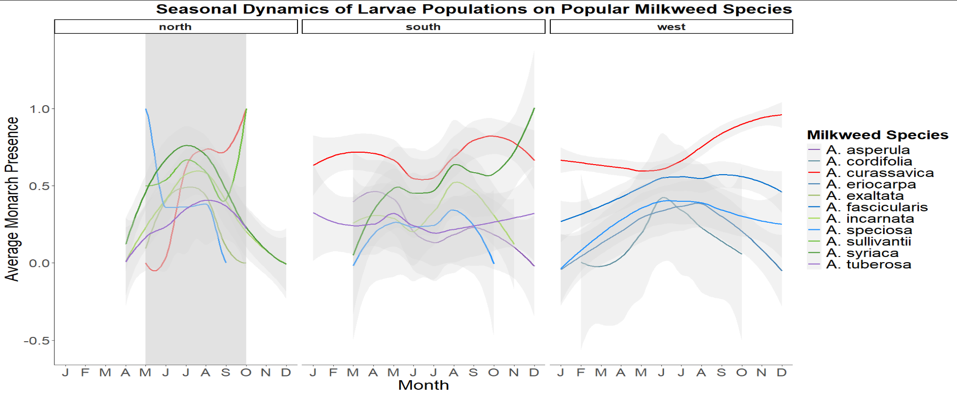
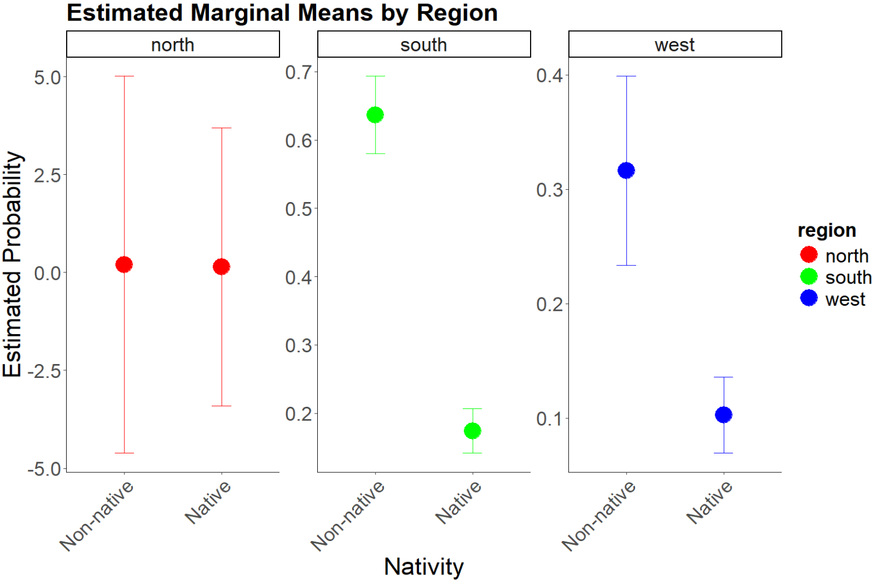
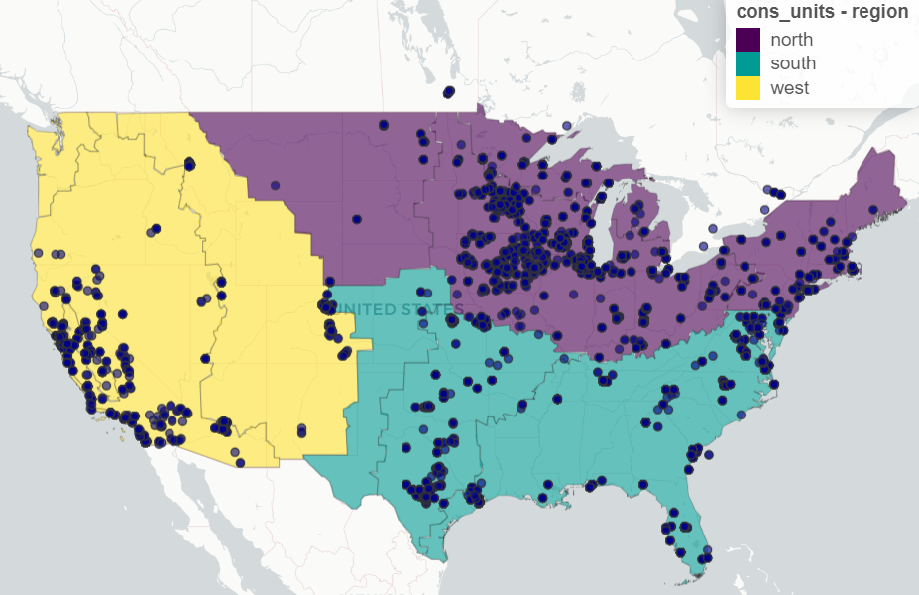
USING CITIZEN SCIENCE DATA TO EXPLORE MONARCH LARVAE PRESENCE ON DIFFERENT MILKWEED SPECIES
CeLee Terasa, Maggie Church, Laura Lukens
BACKGROUND
PRELIMINARY FINDINGS
Probability of larval presence/absence is highly variable by region, and there may be correlation with nativity
Milkweed Species Analysis:
Milkweed Nativity Analysis:
BACKGROUND
MILKWEED-LARVAE RELATIONSHIPS
PRELIMINARY FINDINGS
Monarch butterflies (Danaus plexippus) are widely distributed but face significant challenges due to habitat loss and climate change.
Their larvae rely exclusively on milkweed (mostly Asclepias spp.), sequestering toxic cardenolides for chemical defense against
Milkweed preference: The most frequently observed larval host plants across all regions were Tropical Milkweed (A. curassavica) and common milkweed (A. syriaca), but each region also had variability in milkweed popularity.
Analysis of cardenolide content in these species may yield additional insights into larva-plant relationships.
South: No statistically significant results, though A. curassavica and A. syriaca have slightly higher monarch presence probability
West: A. curassavica = high probability, followed by A. fascicularis
North: A. curassavica, A. syriaca, and others have relatively high probabilities of monarch presence
Figure 1. Monarch migration patterns across the contagious US created by Monarch Watch. Note there are separate breeding populations based on region.
predators and parasites.
Understanding the relationship between monarch larvae presence and milkweed species could provide valuable insights for conservation and habitat management.
Figure 3. Though larvae are found on a variety of milkweed species popularity varies greatly with region.
RESEARCH QUESTION
Are monarch larvae more likely to be present on certain milkweed species in different migratory regions? Does this differ between native and non-native species?
Seasonal trends: Non-native species like Tropical Milkweed (A. curassavica) can support larvae year-round in some regions (especially the South), likely due to their persistence in warm climates.
Figure 5. Plotting the probability of monarch presences across each region shows the highest probability for all regions points to our non-native species, A. curassavica.
South: non-natives have 8.4x higher chance of having monarchs than natives
North: 1.6x higher for non-natives, and barely significant at 0.01-
West: : 4.1x higher for non-natives
BACKGROUND
METHODS
Data Sources:
Monarch presence data was provided by Monarch Joint Venture through two citizen science programs: the Monarch Larva Monitoring Project (MLMP) and the Integrated Monarch Monitoring Program (IMMP).
Spanning 25 years, the dataset
Figure 4. Certain milkweed spp. are more favored by larvae during different seasons, particularly due factors such as precipitation, growing season length, and timing of plant emergence.
CONSERVATION IMPLICATIONS
This project gives insight into monarch-milkweed preference and is one of few field-based investigations into the subject.
Our results indicate that non-native milkweeds (esp. A. curassavica) may play a larger role in monarch larval success or egg-laying preference than previously recognized.
Regional differences suggest conservation strategies should be location-specific (e.g., non-natives may help monarch populations in the South, but less so in the North).
Further research is needed to understand cardenolide content and its impact on larvae survival.
Figure 6. Plotting the probability of monarch presences across each region shows that Tropical Milkweed has a significant chance of being a host for larvae, especially in the South and West regions.
Figure 2. Survey sites. Data was categorized into three regions based on migratory groups: North, West, and South.
REFERENCES
Background photo: https://www.fws.gov/media/12-tranter-catapillarjpg
USFWS caterpillar photo: https://w
ww.fws.gov/media/monarch-caterpillar-2
Monarch Migration map: https://www.monarchwatch.org/migration/
includes observations of monarch larvae on over 70 spp. of milkweed across the contiguous U.S. (though we narrowed down to about 30 spp.)
Statistical Modeling:
Generalized linear binomial models were used to analyze monarch presence/absence while controlling for overinflated zeros and inconsistent milkweed density reporting in the dataset.
Predictor variables: site ID, year (random), month, milkweed species, nativity (fixed).
REFERENCES
Notes:
Background:
Limitations of data: zero inflated, outliers, possible data entry errors
Study Design/Methods:
Narrow milkweed species from 73 to around 30 (by eliminating spp that appear in less than 40 surveys) to simplify modeling
Eliminated monarch egg data and all data in Florida, since there may be lots of inaccuracies in South region b/c eggs look identical to Queen Butterfly eggs
Avoided use of monarch density data due to inconsistences in how milkweed density is determined for each survey type
Statics:
mwspecies model does not converge when year is a fixed effect (in the south).
Month is insignificant and actually lowers AIC, whether used as a random or fixed effect

